Slide 1

HEALTHCARE ANALYSIS
PRESENTATED BY -
GROUP 3
MEMBERS :-
ASHISH RANJAN
IPSHA RANI SETHY
SUPRIYA JALINDAR JADHAV
MANAS SUGANDH POTDAR
TANISHKA MAHESHWARI
SONAL M. KHOBRAGADE

Slide 2
PROJECT OVERVIEW
INTRODUCTION:
Healthcare Data Analysis project focuses on examining electronic health records from our medical facilities to improve patient care. By analyzing transactional data from patient interactions with our healthcare system ranging from appointment scheduling to medication dispensing we aim to gain valuable insights into patient treatment outcomes, preferences in care delivery types, and overall healthcare service efficiency. This analysis is crucial for understanding patterns that can drive strategic decisions on how to enhance the platform’s performance and patient care experience.
OBJECTIVES:
Analyze Patient Data: This section aims to analyze medical trends between weekdays and weekends regarding treatment methods preferred by patients.
Evaluation Review between Hospitals Types: Investigate the relationship between services provided by different hospitals to understand patient satisfaction and facility type preferences.
Assessment for Patient Care Satisfaction: Determine the average delivery time and treatment in terms of admissions and discharges.
Analysis for Healthcare Logistics: Explore strategies for improving logistics within hospital systems.
Investigation Appointment Days vs Patient Feedback Scores: Examine possible correlations between scheduling options offered by different departments or specialists.
These insights will empower our healthcare system to make informed decisions, optimize its performance, and enhance the overall patient care experience.
IMPORTANCE:
Understanding these elements is vital for optimizing various facets of the healthcare system. By identifying key trends and patterns, medical professionals can enhance operational efficiency, improve patient care quality, and tailor health strategies to meet the unique requirements of a diverse patient population. The insights gained from this analysis will not only inform clinical decisions but also support a more efficient and patient-focused model in the challenging healthcare industry.

Slide 3
MASTER DATASET TABLE
Hospital Quarterly Financial Utilization Report Dataset-1
Report Dataset-2
Report Dataset-3
Report Dataset-4
Report Dataset-5
Report Dataset-7
Report Dataset-8
Report Dataset-9
Report Dataset-10
Report Dataset-11
Report Dataset-12
Report Dataset-13
Report Dataset-14
Report Dataset-17
Report Dataset-18
Report Dataset-19
DATASET SCHEMA

Slide 4
EXTRACT DATA
TRANSFORMATION
MERGING, LOADING & USING TOOLS
KPIs CREATION & VISUALIZATION
DASHBOARD ANALYSIS USING DIFFERENT MODULES
PROJECT METHODOLOGY

Slide 5
PROJECT ANALYSIS
Data storage through multiple CSV flies
Insufficient information
Lacks of analytics insights to make business decisions
Reduce data storage
Create efficient Query and analysis
Empower data driven decision making capability
Data Normalization
Create a normalized relation as a central data to collect files in a workbook
ETL Process Optimization
Conduct data manipulation and data cleaning with Excel and MySQL
Analytics Insights
Generate analytical insights through an interactive dashboard via Excel, Power BI, Tableau

Slide 6




Tools used and their roles
EXCEl
Role: The initial step involved importing the CSV files into Excel for data cleaning and preliminary exploration. Excel was used to handle missing values, correct data inconsistencies, and organize the dataset. It also facilitated basic calculations and the creation of preliminary charts to understand the data better before further analysis.
MYSQL
Role: After cleaning the data in Excel, it was imported into MySQL for creating a structured database. MySQL was used to perform complex queries and aggregations to generate key performance indicators (KPIs). The relational database allowed for efficient data management and querying, which was crucial for detailed analysis.
POWER BI
Role: With the database set up in MySQL, data was imported into Power BI via a MySQL database connection. Power BI was used to create interactive and dynamic dashboards. It enabled the visualization of KPIs and trends through various charts and graphs, providing insights into payment statistics, delivery times, and other key metrics.
TABLUE
Role: Similarly, data was imported into Tableau using the MySQL database connection. Tableau was employed for advanced data visualization, allowing for the creation of detailed and visually appealing charts. It helped in exploring complex relationships and patterns in the data, facilitating an engaging presentation of the insights derived from the analysis

Slide 7







Total Discharge
Patient Days
Net Patient Revenue
Revenue Trend
State wise No of Hospital Revenue
Type of Hospital Revenue
QTD YTD Revenue
Total Patient, Total Doctors, Total Hospitals
Two Custom KPI’s -
1.Teaching and Rural Hospital revenue
2.Top 3 Facility revenue
KEY PERFORMANCE INDICATORS (KPI’s)

Slide 8

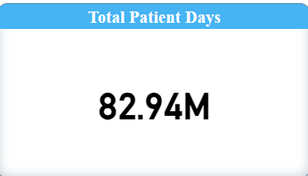
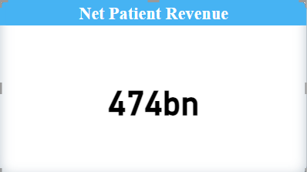
KPI’s Observation
TOTAL DISCHARGE:
Observations:
The "Total Hospital Discharges" represents the aggregate number of patient discharges from hospitals within a specific period. In the provided chart, this figure is 13.92 million. The chart further breaks down these discharges by different payer types and healthcare programs.
Implication:
Understanding total discharges helps healthcare providers and administrators in planning and allocating resources, such as staffing, hospital beds, and medical supplies, to meet patient needs efficiently.
TOTAL PATIENT DAYS:
Observations : This metric represents the aggregate number of days that all patients have spent in a hospital during a specific period.
Implication :
Total patient days provide a clear picture of the hospital's workload. A higher number indicates that the hospital is consistently busy, reflecting both the volume of patients and the length of their stays.
NET PATIENT REVENUE:
Observations :
Net Patient Revenue (NPR) is the total revenue of healthcare facility generates from providing patient care services, after deducting discounts, allowances, and adjustments.
Implication:
Understanding NPR is vital for effective budgeting and financial planning.

Slide 9
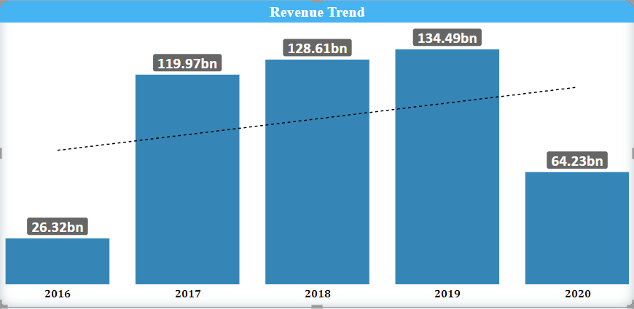
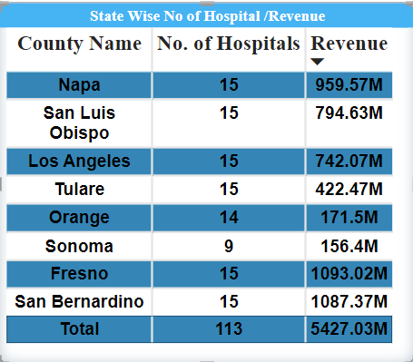
REVENUE TREND:
Observations:
A revenue trend refers to the pattern or direction in which organization's revenue is moving over a specific period of time,it involves analyzing how a organization’s revenue changes from year to year.
Implication:
The chart indicates overall revenue growth, as shown by the upward trendline, but also highlights a significant recent drop in revenue. This suggests the need for immediate action to address potential issues.
STATE WISE NO. OF HOSPITAL REVENUE
Observations : The table shows data on the state wise number of hospitals and corresponding revenue for different counties.
Counties: There are eight counties listed, each with a different number of hospitals.
No. of Hospitals: Most counties have 15 hospitals, except Orange (14) and Sonoma (9).
Revenue: The revenue generated by each county’s hospitals is listed, ranging from 156.4M (Sonoma) to 1093.02M (Fresno).
Total: The total number of hospitals is 113, with a combined revenue of 5427.03M.
Implication: Counties with high revenues might be models for best practices, while those with lower revenues could benefit from targeted investments or operational improvements.

Slide 10
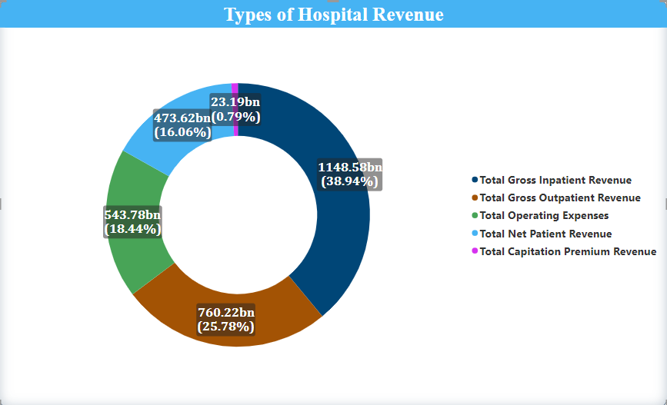
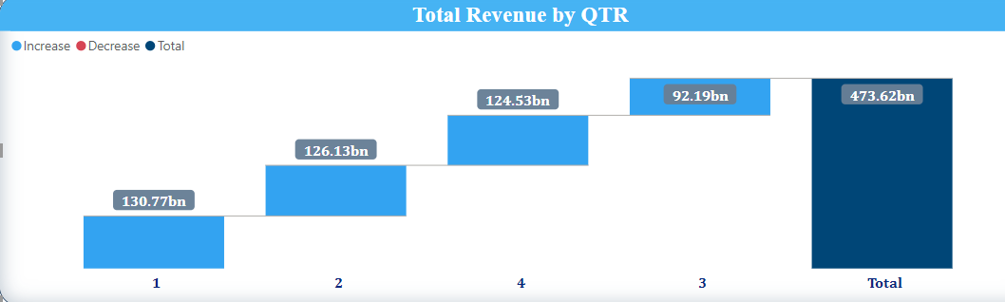
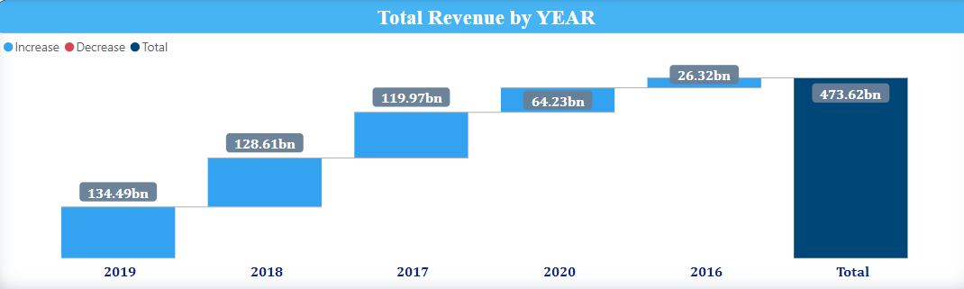
6. TYPES OF HOSPITAL REVENUE
Observations : The "Type of Hospital Revenue" KPI refers to different streams of revenue that a hospital or healthcare facility generates. This KPI is typically broken down into categories that reflect various revenue sources.
Implication:
The " Types of Hospital Revenue" refers to various income streams within a hospital, including inpatient and outpatient services, surgeries, diagnostics, pharmacy, and emergency care.
QTD/YTD REVENUE:
QTD Observations:
QTD revenue tracks the total income a hospital or organization has generated from the start of the current quarter to the present date.
Implication :
This KPI allows for real-time monitoring of financial performance during a specific quarter, enabling organizations to evaluate if they are on track to meet quarterly goals
YTD (Year-to-Date) Observations: YTD revenue measures the total income generated from the beginning of the current year up to the present date.
Implication :
YTD revenue is a crucial metric for evaluating annual financial goals and overall business health. By comparing YTD revenue with previous years or targets.
- Both QTD and YTD revenue KPI help in tracking financial performance at different time scales, offering both short-term and long-term insights.

Slide 11
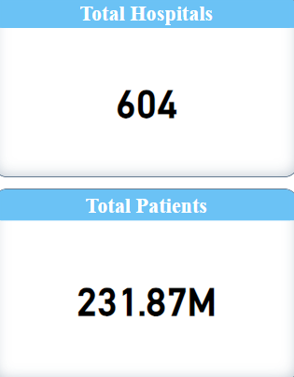
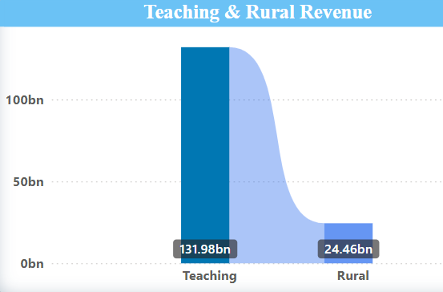
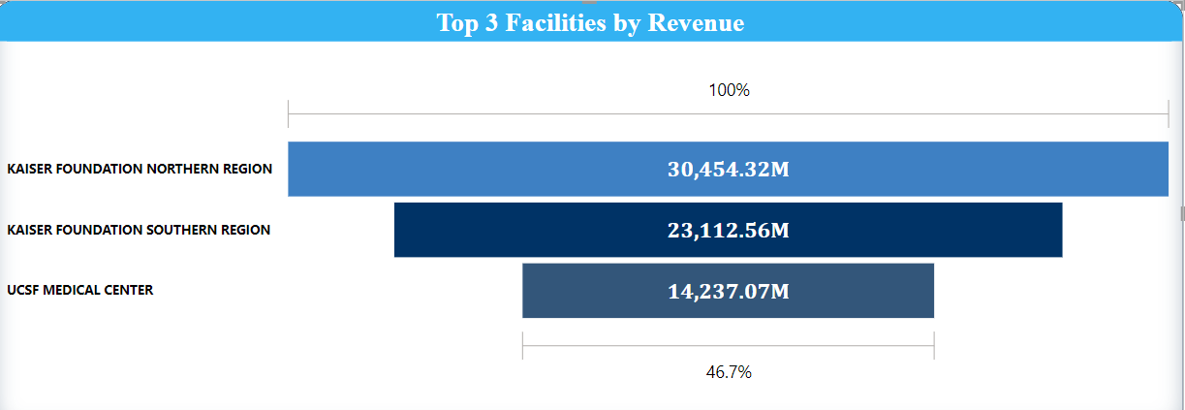
8)Total Patients, Total Hospitals
Observations :
This KPI measures the total number of Patients,Total number of hospitals.
Implication:
These KPI collectively provide a comprehensive view of the hospital's operational scale, capacity, and service capability.
9. Teaching and Rural Revenue
Observations :
The Teaching Revenue KPI tracks income generated by hospitals that serve as teaching facilities.
The Rural Revenue KPI measures the income generated by hospitals located in rural or underserved areas.
Implication:
-Teaching hospitals play a critical role in medical education and research, and this KPI helps monitor their financial sustainability.
-Rural hospitals often face challenges such as limited resources, lower patient volumes, and difficulty attracting medical professionals.
10 . Top 3 Facilities by Revenue
Observations :
The "Top 3 Facilities by Revenue" KPI highlights the three highest revenue-generating hospitals or healthcare facilities within a healthcare system
Implication :
Tracking the "Top 3 Facilities by Revenue" helps healthcare organizations focus on financial health, resource optimization, and strategic growth.

Slide 12
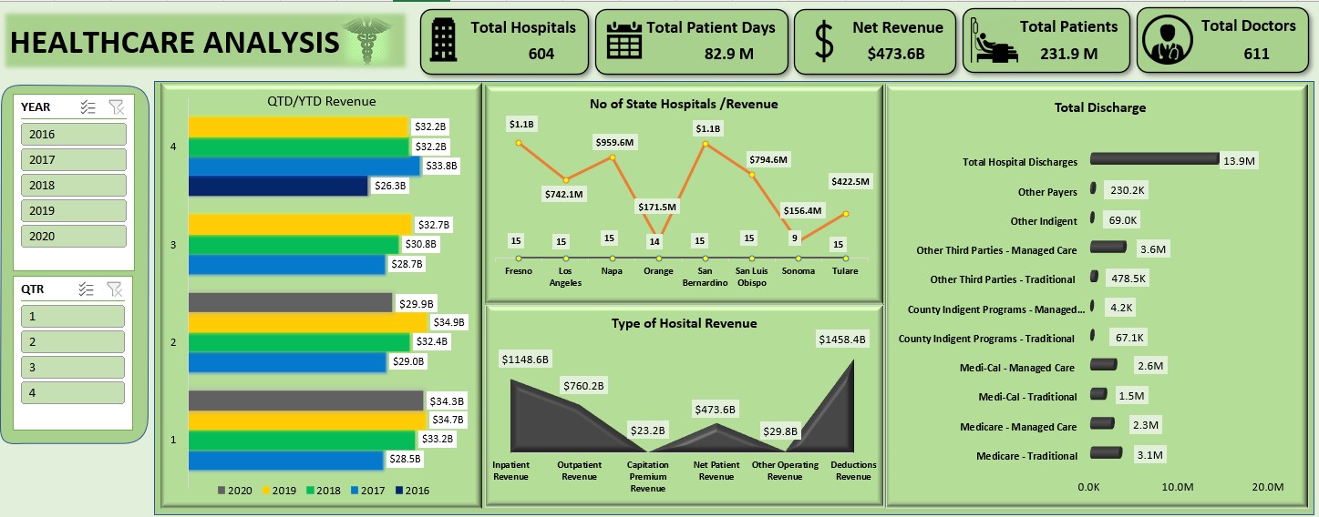

EXCEL DASHBOARD
1

Slide 13
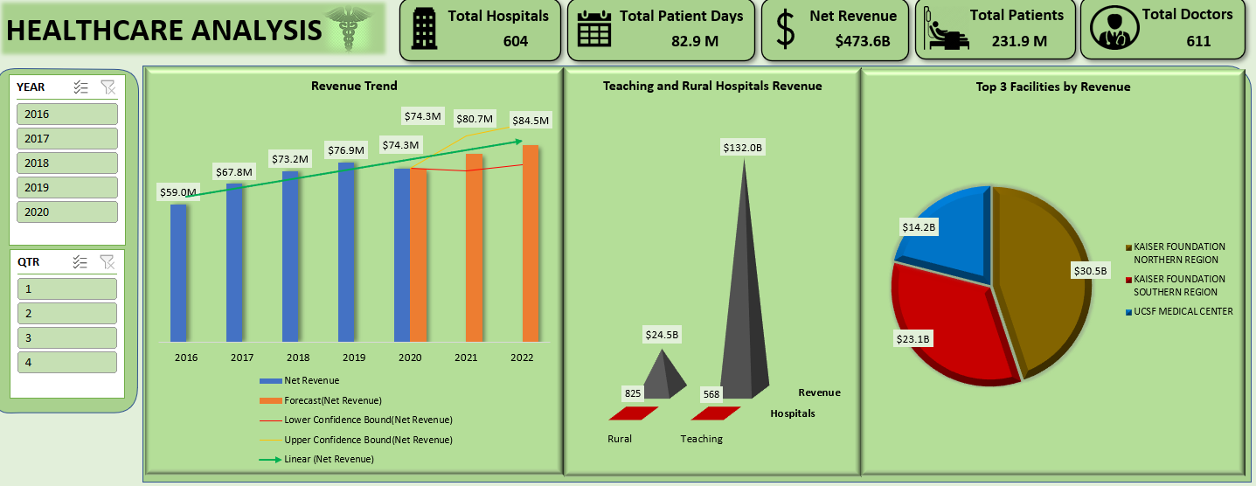
EXCEL DASHBOARD
2

Slide 14
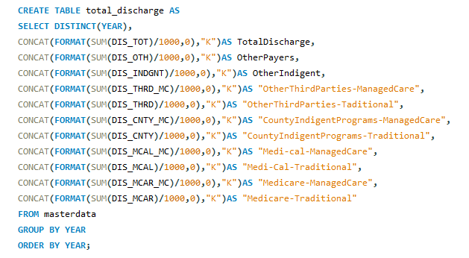
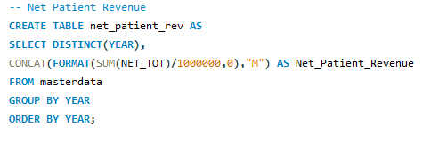
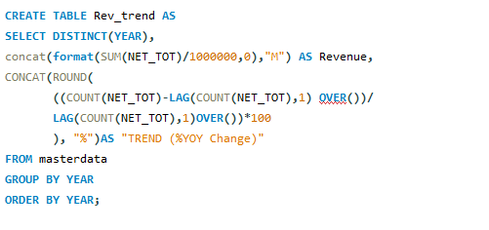
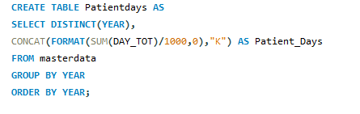
SQL QUERIES
Total Discharge :-
Net Patient Revenue :-
Revenue Trend :-
Patient Days :-

Slide 15
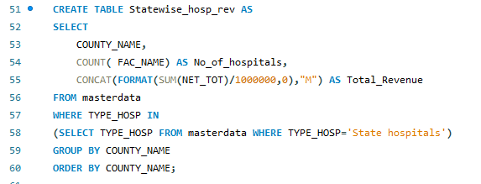
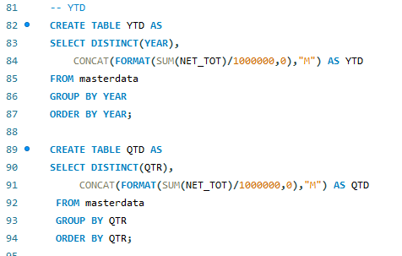
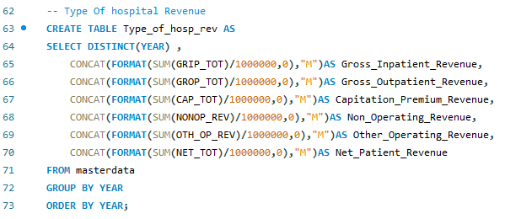
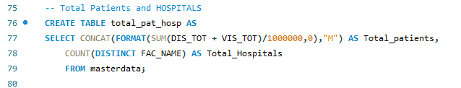
State Wise No of hospital /Revenue :-
YTD/QTD Revenue :-
Type Of hospital Revenue :-
Total Patient & Total Hospital :-

Slide 16
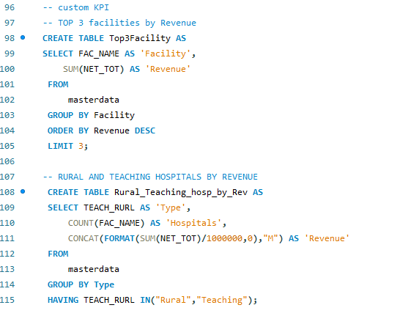
Two Custom KPIs :-

Slide 17
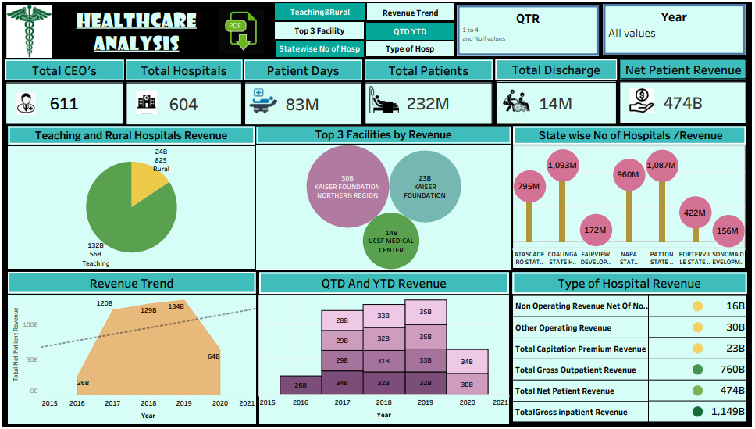

tableau DASHBOARD

Slide 18
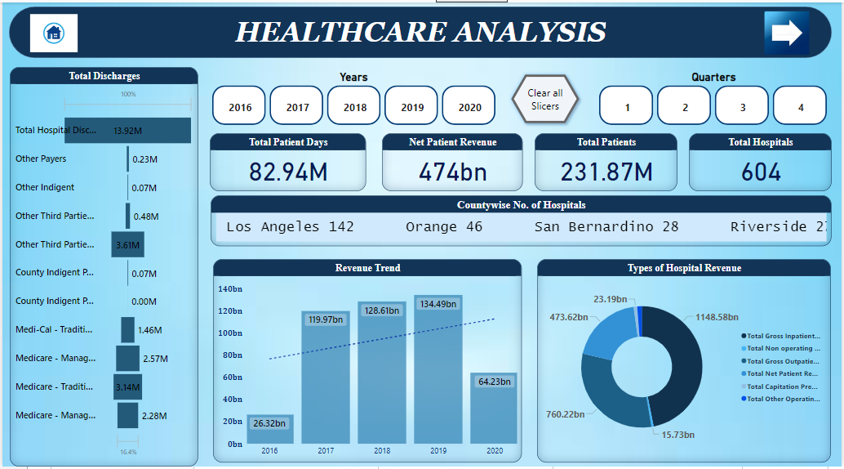

Power bi DASHBOARD
1

Slide 19
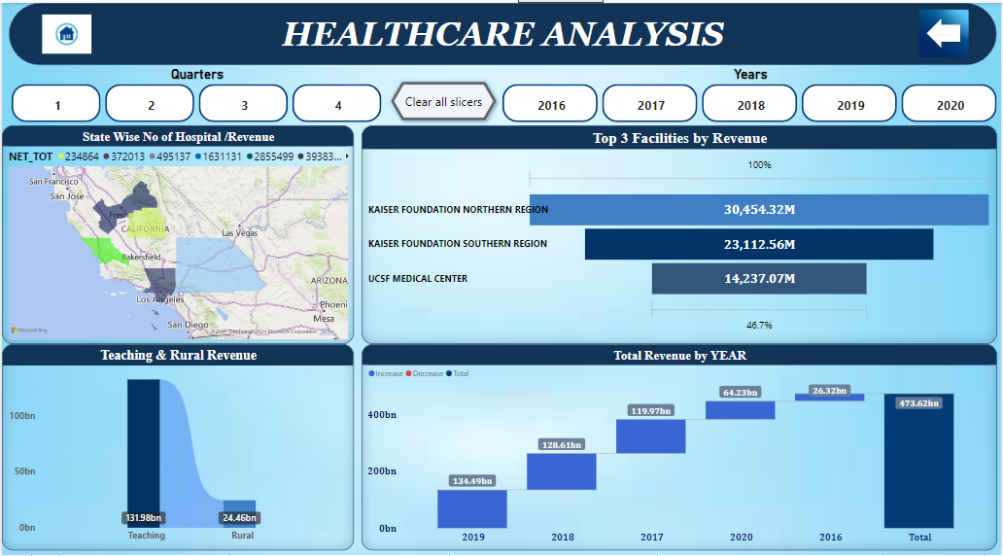
Power bi DASHBOARD
2

Slide 20
Insights and suggestions
1.Patient Days
Description: The total number of days patients spend in the hospital.
Suggestion: Monitor trends in patient days to assess hospital utilization and identify potential inefficiencies or capacity issues. High patient days may indicate longer stays, which could be due to complex cases or delays in discharge.
Impact: Optimizing patient days can reduce costs, improve patient turnover, and enhance bed availability for new patients.
2. Total Discharge
Description: The total number of patients discharged from the hospital.
Suggestion: Analyze discharge trends to understand patient flow and the effectiveness of care. Break down by type of discharge (e.g., Medicare, Medi-Cal) to identify specific areas for improvement.
Impact: Increasing discharge rates while maintaining quality care can lead to higher patient turnover, better resource utilization, and improved financial performance.
3. Net Patient Revenue
Description: The total revenue generated from patient care services.
Suggestion: Compare net patient revenue against operational costs to assess profitability. Identify trends in revenue generation across different services and patient types.
Impact: Optimizing revenue streams can lead to financial sustainability, enabling reinvestment in patient care, technology, and staff.
4. State-wise Number of Hospitals and Revenue
Description: The number of hospitals and the corresponding revenue generated in each state.
Suggestion: Use this KPI to identify high-performing states and those that may require strategic interventions. Consider factors like population density, healthcare needs, and competition.
Impact: Understanding state-wise performance can help allocate resources more effectively and tailor strategies to regional needs

Slide 21
5. QTD (Quarter-to-Date) and YTD (Year-to-Date) Metrics
Description: Revenue and performance metrics tracked quarterly and yearly.
Suggestion: Regularly compare QTD and YTD performance to track progress against targets and identify seasonal trends. Use this data for mid-year adjustments to strategies.
Impact: Timely insights from QTD and YTD metrics allow for proactive management, helping to meet annual goals and respond quickly to emerging challenges.
6. Type of Hospital Revenue
Description: Revenue categorized by the type of hospital (e.g., teaching, rural).
Suggestion: Analyze revenue by hospital type to identify strengths and areas for growth. Teaching hospitals may have different revenue patterns compared to rural hospitals.
Impact: Understanding revenue by hospital type can inform decisions on service offerings, partnerships, and investments in specific types of facilities.
7. Revenue Trend
Description: The trend of revenue over time, including growth or decline.
Suggestion: Use trend analysis to forecast future revenue and identify periods of growth or decline. Correlate with external factors such as policy changes or economic conditions.
Impact: Tracking revenue trends helps in financial planning and strategy development, ensuring long-term sustainability.
8. Teaching and Rural Hospital Revenue
Description: Revenue generated by teaching and rural hospitals.
Suggestion: Compare the revenue performance of teaching and rural hospitals to urban or general hospitals. Identify unique challenges or opportunities in these settings.
Impact: Enhancing revenue in teaching and rural hospitals can improve access to care in underserved areas and support specialized medical education.
9. Total Patient and Total Doctors And Total Hospitals
Description:
This KPI tracks the total number of patients, doctors, and hospitals within your healthcare system.
Suggestions: Patient-to-Doctor Ratio: Calculate the ratio of patients to doctors to ensure adequate staffing levels. A high patient-to-doctor ratio may indicate potential understaffing, which could affect the quality of care.
Hospital Distribution: Analyze the distribution of hospitals across different regions. Identify areas with higher patient demand but fewer hospitals, which might require additional resources or new facilities.

Slide 22
Challenges and Solutions
Problem:- Two file formats while importing in excel. One in excel and one in csv.
Solution- Imported files individually.
Problem:- Wrong date formats in data set.
Solution- Changed in power query.
Problem:- Wrong data formats for numbers in few columns in data sets.
Solution- Changed data format in excel file before importing.
Problem:- One file in outdated excel format.
Solution- Created table and copied it in latest excel file.
Problem:- Error while importing file in MySQL.
Solution- Used upended file in excel with corrected data formats.
Problem:- Problem while connecting MySQL database to Power Bi.
Solution- Downloaded proper connector and MySQL server.

Slide 23
Conclusion
The healthcare analytics report highlights the significant impact of 604 hospitals over four years, demonstrating robust patient care with over 231.87 million patients served and financial strength with $473.62 billion in net earnings from patient services.
This report is crucial for healthcare stakeholders, providing actionable insights to optimize resource allocation, enhance financial sustainability, and improve patient outcomes. The findings will help guide future investments and decision-making, ensuring that healthcare organizations remain adaptable, efficient, and capable of delivering high-quality care across diverse population.

Slide 24
THANKYOU !!!
FROM GROUP 3

